Slide 1

Cascading Style Sheets
C S S

Slide 2
What is CSS?
A simple mechanism for controlling the style of a Web document without compromising its structure.
It allows you to separate visual design elements (layout, fonts, colors, margins, and so on) from the contents of a Web page.
Allows for faster downloads, streamlined site maintenance, and global control of design attributes across multiple pages.

Slide 3
CSS vs. just HTML
What can we do with CSS that we can’t do with HTML?
  Control of backgrounds.
  Set font size to the exact height you want.
  Highlight words, entire paragraphs, headings or even individual letters with background colors.
  Overlap words and make logo-type headers without making images.
  Precise positioning.
  Linked style sheets to control the look of a whole website from one single location.
  And more.

Slide 4
How to write CSS?
Selector
  HTML element tags
  (examples: p, h2, body, img, table)
  class and ID names
Property (examples: color, font-size)
Value (examples: red, 14pt)

Slide 5
How to write CSS:
The basic syntax of a CSS rule:
selector {property 1: value 1; property 2: value 2}
Example:
p {font-size: 8pt; color: red}
Notice the { } around the rule and the : before each value!

Slide 6
Three ways to include CSS:
Local (Inline)
Global (Embedded, or Internal)
Linked (External)

Slide 7
1. Local
Inline style sheet.
Placed inside tags.
Specific to a single instance of an html tag on a page.
Must be used instead of <font> tags to specify font size, color, and typeface and to define margins, etc.
Use to override an external or embedded style specification.

Slide 8

Local (inline)
Example
  <p style="font-size: 10pt; color: red; font-weight: bold; font-family: Arial, Helvetica, sans-serif">
  This is a local stylesheet declaration. </p>
On the browser:

Slide 9
2. Global
Embedded or internal style sheet
Applicable to an entire document
Styles are defined within the <style> </style> tag, which is placed in the header of the html file (i.e., within <head> and </head>).

Slide 10
Global (Internal)
Example:
  <html>
  <head>
  <title>Title</title>
  <style type="text/css">
  <!--[STYLE INFORMATION GOES HERE] -->
  </style>
  </head>
  <body>
  [DOCUMENT BODY GOES HERE]
  </body>
  </html>

Slide 11
3. Linked
External style sheet
Styles are saved in a separate file, with the extension .css
This single stylesheet can be used to define the look of multiple pages.

Slide 12
Linked (External)
Example
Save this text file as whatever.css
In TextPad,Notepad, etc.…
  p {font-family: verdana, sans-serif; font-size: 12pt; color: red}
  h1 {font-family: serif; font-size: 14pt; color: green}
  h2 {font-family: serif; font-size: 11pt; color: blue}

Slide 13
Linked (External)
Example (continued)
To apply the stylesheet “whatever.css“ to an HTML document, call it in from the header:
  <head>
  <link rel="stylesheet" href=“whatever.css" type="text/css">
  </head>

Slide 14
Inheritance: which style prevails when several are present?
Inline (local) overrides internal (global)
Internal (global) overrides external (linked).

Slide 15
Cascading
The way styles will be used when there is more than one style specified for an HTML element:
Browser default
External Style Sheet (Linked) (in an external .css file)
Internal Style Sheet (Global, or embedded) (inside the <head> tag)
Inline Style (Local) (inside HTML element)
An inline style (inside an HTML element) has the highest priority, which means that it will override every style declared inside the <head> tag, in an external style sheet, and in the browser (default value).

Slide 16
Let’s try this now!
  <h1 style=“text-align: center; font-weight:bold; color: blue”> Styling with CSS! </h1>
  <p style="font-size: 10pt; color: red; font-weight: bold; font-family: Arial, Helvetica, sans-serif“ >
  Write whatever you want here </p>

Slide 17
Grouping properties
Separate properties with a semi-colon
  Example:
p {text-align:center;color:red; font- family:Arial; font-style:italic}

Slide 18
Grouping selectors
Separate selectors with a comma
  Example:
h1,h2,h3,h4,h5,h6 { color: green }
(each header will be green)
Separate selectors with a space
  Example:
p li { color: red }
(only items within a list and a paragraph tag will be red)

Slide 19
The class Selector
With a class selector you can define different styles for the same type of HTML element
Examples:
First define the class:
  p.right {text-align: right; color: red; font-style: italic}
  p.blue {text-align: center; color:blue}
Then use the class in your HTML code :
  <p class="right"> This paragraph will be right-aligned, italic, and red. </p>
  <p class=“blue"> This paragraph will be center-aligned and blue. </p>

Slide 20
The class Selector
You can also omit the tag name in the selector to define a style that will be used by all HTML elements that have this class.
Example:
.poem {text-align: center; font-style:italic}
Any HTML element with class=“poem" will be center-aligned and italic.

Slide 21
The class Selector
Example (continued)
Both elements below will follow the rules in the ".poem“ class:
  <h1 class=“poem"> This heading will be center-aligned and italic </h1>
  <p class=“poem"> This paragraph will also be center-aligned and italic. </p>

Slide 22
Class Example
<style>
p {font-family: sans-serif; font-size: 10pt}
h1 {font-family: serif; font-size: 30pt}
h2 {font-family: serif; font-size: 24pt}
.boldred {color: red; font-weight: bold}
.green {color: green}
.tinyblue {color: blue; font-size: 8pt}
</style>
The tags and classes can then be used in combination:
<h1 class=“boldred">This is rendered as 30-point red serif bold text.</h1>
<p class=“boldred">This is rendered as 10-point red sans-serif bold text.</p>

Slide 23
Applying styles to portions of a document:
<div>
  A division tag: to “package” a block of document into one unit. It defines a block element.
  Causes a line break, like <br> and <p>.
<span>
  “Wraps” a portion of text into a unit, but doesn't cause a line break. Allows styles to be applied to an 'elemental' region (such as a portion of a paragraph).

Slide 24
Example
<p><span class="foo">This text is rendered as foo-style</span> and this is not. </p>
<div class="foo">
<p>The "foo" style will be applied to this text, and to <a href="page.html">this text</a> as well.
</div>

Slide 25
List of style Selectors and their Properties and Values:
From WDG:
http://www.htmlhelp.com/reference/css/properties.html

Slide 26
Properties - Font
font-family
  Name, or serif, sans-serif, cursive, monospace
font-style
  normal, italic
font-weight
  normal, bold, 100, 200, 300, 400, 500, 600, 700, 800, 900
font-size
  absolute-size, relative-size, length, percentage
font-variant
  small-caps

Slide 27
Properties - Text
text-decoration
  underline, line-through
text-transform
  capitalize, uppercase, lowercase, none
text-align
  left, right, center, justify
text-indent
  <length>, <percentage>

Slide 28
Properties - Position
position
  absolute, relative
top
  <length>, <percentage>, auto
left
  <length>, <percentage>, auto
Z-index
  <number>, auto

Slide 29
A few more details about positioning

Slide 30
Positioning
X
(0,0)
Upper left corner corresponds to (0,0)
The value of top, bottom, right, left
can be expressed in:
  Length (measured in px, em, etc…)
  Percentage of the parent’s width
Y

Slide 31
The z-index
stacking order is called the z-index.
If elements overlap each other, the one with the higher z-index appears on top.
Example:
  .topElement {position: absolute; z-index=2; top:0px; left:0px; font-size:36pt; color:red}

Slide 32
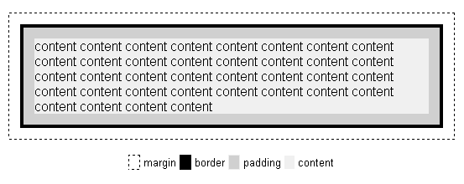
Using Boxes and Positioning for layout

Slide 33
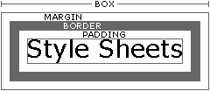
In a box:
Margins are always transparent.
Borders come in various styles.
Background settings:
  the area just inside the borders
  includes both the padding and content areas.

Slide 34
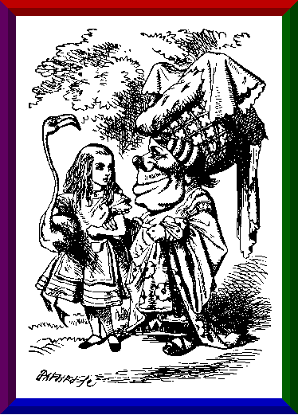
Examples
img { border-style: ridge;
border-width: 20px;
border-color:red green blue purple}
h1 {background-color: #CC66FF;
width: 50%;
padding: 20px}
H1,50% ,purple background

Slide 35
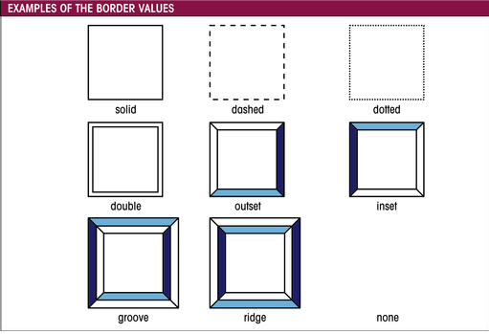
Border values

Slide 36
More fun stuff with CSS

Slide 37
Backgrounds
background-color
  Hex
background-image
  URL(image.jpg)
background-repeat
  No-repeat, repeat-x, repeat-y
background-attachment
  Fixed, scroll
background-position
  Top, left
    p { background-position: 70px 10px; background-repeat: repeat-y; background-image: url(background.gif) }

Slide 38
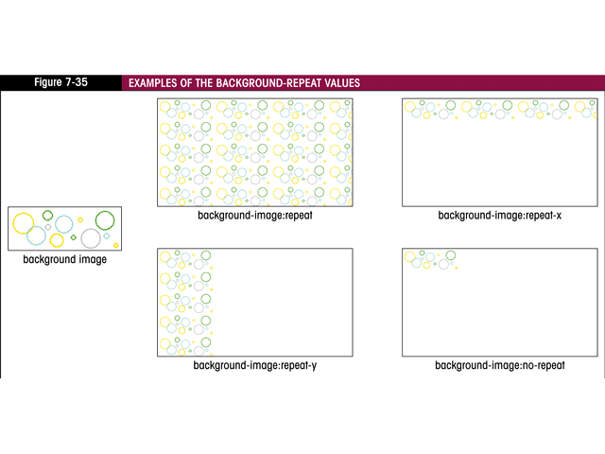
Background repeat examples:

Slide 39
Scroll Bar Color
Example:
<style>
body { color:black;
background-color:#a0a0a0;
scrollbar-face-color:#903030;
scrollbar-arrow-color:#FFFFFF;
scrollbar-track-color:#C0B0B0;
scrollbar-shadow-color:rgb(0,0,0)}
</style>
CSS generator for scrollbars: http://www.spectrum-research.com/V2/generators/scrollbar.asp

Slide 40
Link Style
a:link {color: #FFFFFF; text-decoration: none}
a:visited {color: #808080; text-decoration: none}
a:hover {color: red; text-decoration: none}

Slide 41
Cursor
The cursor property specifies the type of cursor to be displayed when pointing on an element.
  Crosshair, hand, move, text, wait, etc.
Complete demo (cursor styles): http://www.w3schools.com/css/tryit.asp?filename=trycss_cursor

Slide 42
CSS Resources

Slide 43
Demos
http://www.w3schools.com/css/demo_default.htm

